Slide 1


DEPARTMENT OF COMPUTER SCIENCE AND ENGINEERING
CSB1354 – BUILDING RAG BASED SOLUTIONS
END SEMESTER PRACTICAL EXAMINATION - APRIL/MAY - 2026
Batch No. : 01
Date : 08-05-2026
Session : FN

Slide 2
MULTI - SOURCE RAG ASSISTANT
Guide Name:
Mrs.S.Gayathri,M.E.,
Assistant Professor
Department of CSE
Team Members:
ABDUL RAZEEK A(2303811710421002)
JAYASURYA L(2303811710421066)
KAMALESH S(2303811710421073)
MATHAN M(2303811710421092)

Slide 3
OBJECTIVE OF THE PROJECT
To develop a semantic query engine RAG-powered desktop application capable of processing PDFs, web URLs, and raw text.
To build a context-aware question answering system that retrieves and grounds responses using semantic search and vector embeddings.
To deliver an interactive and accessible chat application with integrated Text-to-Speech (TTS) functionality.

Slide 4
INTRODUCTION
Developed a Retrieval-Augmented Generation (RAG) system using FastAPI and ChromaDB for efficient document retrieval and response generation.
Integrated Google Embeddings and Groq LLM models to process user queries and generate context-based responses.
Implemented PDF/URL ingestion, vector database storage, and real-time query processing for fast and accurate information retrieval.

Slide 5
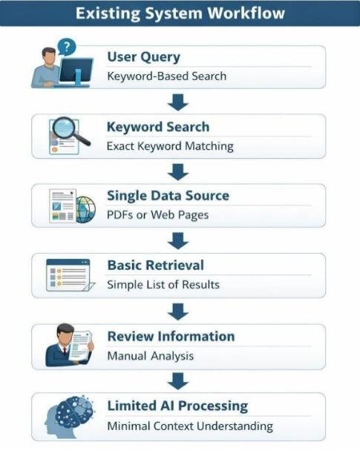
EXISTING SYSTEM

Slide 6
PROBLEM IDENTIFICAITON
Existing systems provide limited context-based retrieval, resulting in less accurate and less relevant responses.
Handling and processing multiple document formats such as PDF and web URLs efficiently remains a major challenge.
Poor integration between vector databases, embedding models, and language models affects retrieval and response performance.
Real-time query processing and scalable document management become difficult when dealing with large volumes of data.

Slide 7
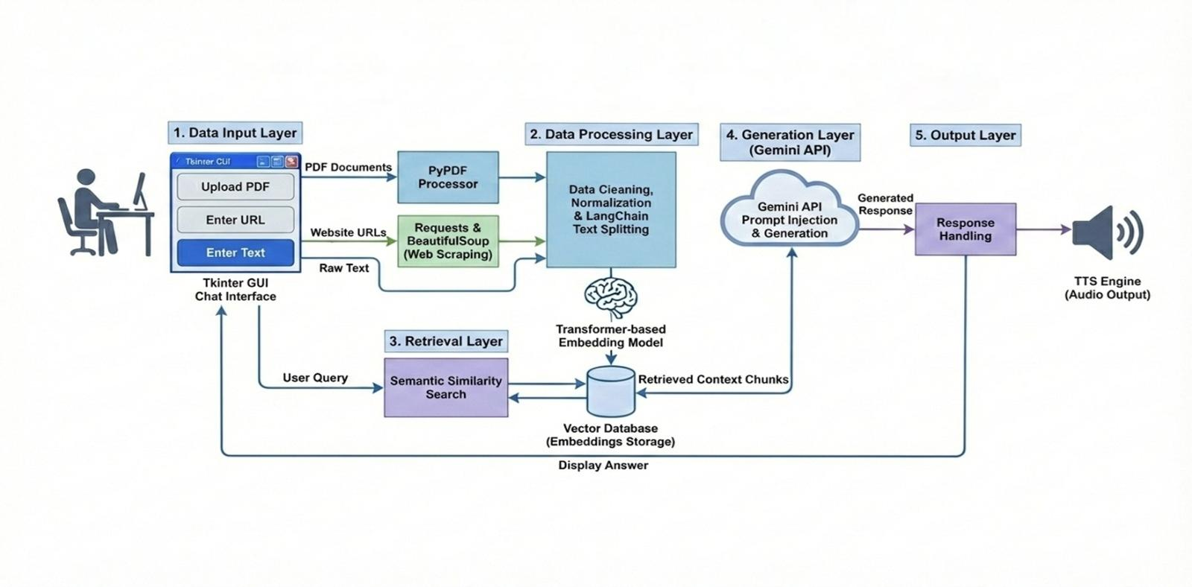
PROPOSED SYSTEM ARCHITECTURE

Slide 8
SOFTWARE AND HARDWARE REQUIREMENTS
HARDWARE
Processor: Intel i5 or higher
RAM: Minimum 8 GB
Storage: 256 GB SSD or higher
Internet: Stable connection for data transfer
SOFTWARE
Frontend: HTML,CSS3,Vannila JS
Backend: Python(FastAPI)
Language: Python,Javascript
IDE: Visual Studio Code
Database: ChromaDB
AI Models:Google Gemini, Groq

Slide 9
MODULES
Data Input Module
Data Processing Module
Embedding and Storage Module
Retrieval Module
Response Generation and Interaction Module

Slide 10
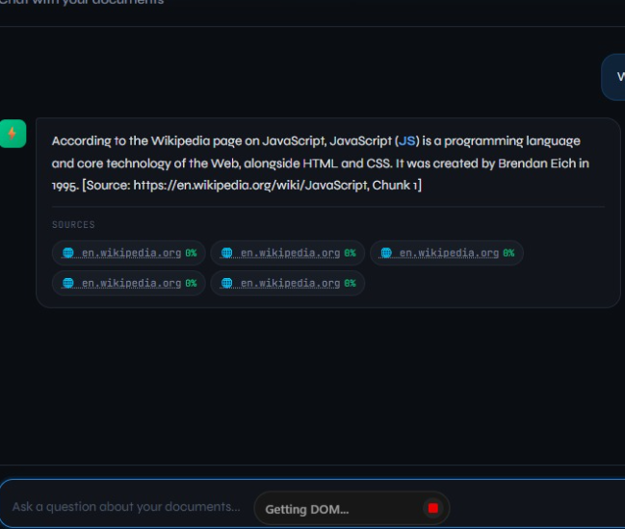
DATA INPUT MODULE
Collects PDF documents and web URLs from the user through the application interface.
Validates uploaded files and URL formats before sending them for processing.
Transfers the collected data securely to the next processing stage.

Slide 11
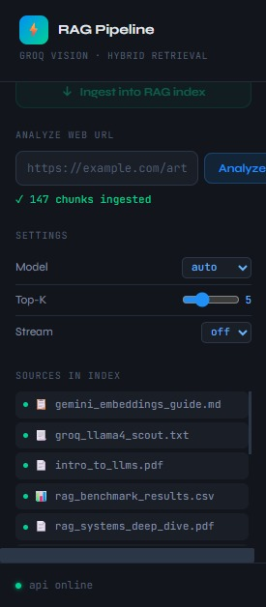
DATA PROCESSING MODULE
Extracts text content from uploaded documents and web pages.
Cleans and preprocesses the extracted text for better accuracy.
Splits large text into smaller chunks for efficient embedding generation.

Slide 12
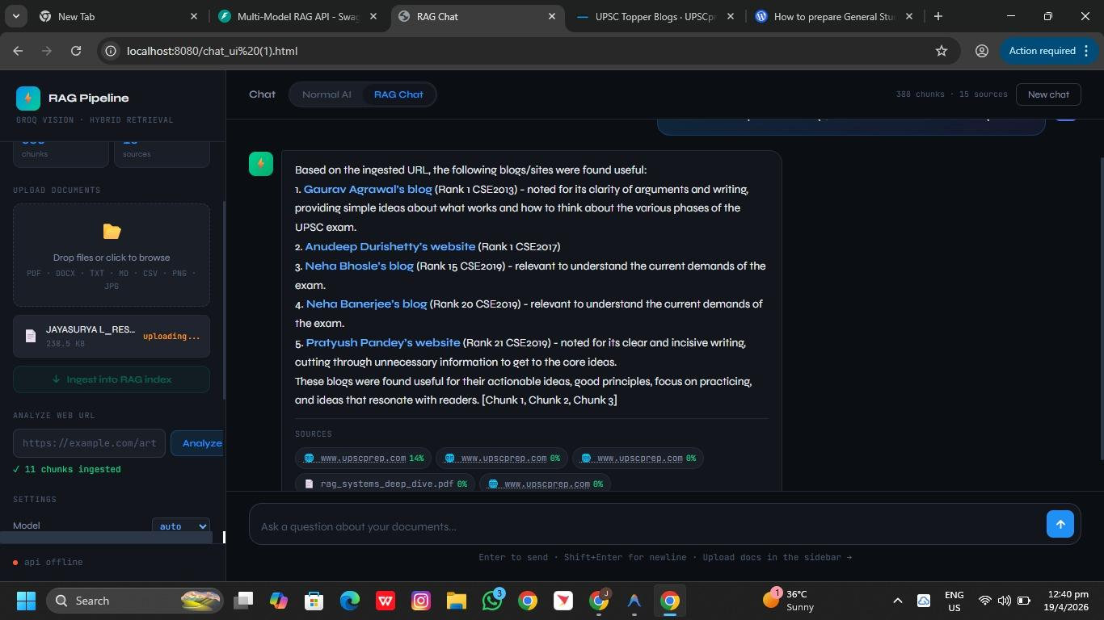
EMBEDDING AND STORAGE MODULE
Generates semantic vector embeddings using Google embedding models.
Stores embeddings and processed text chunks in ChromaDB.
Maintains indexed vector data for efficient semantic retrieval.

Slide 13
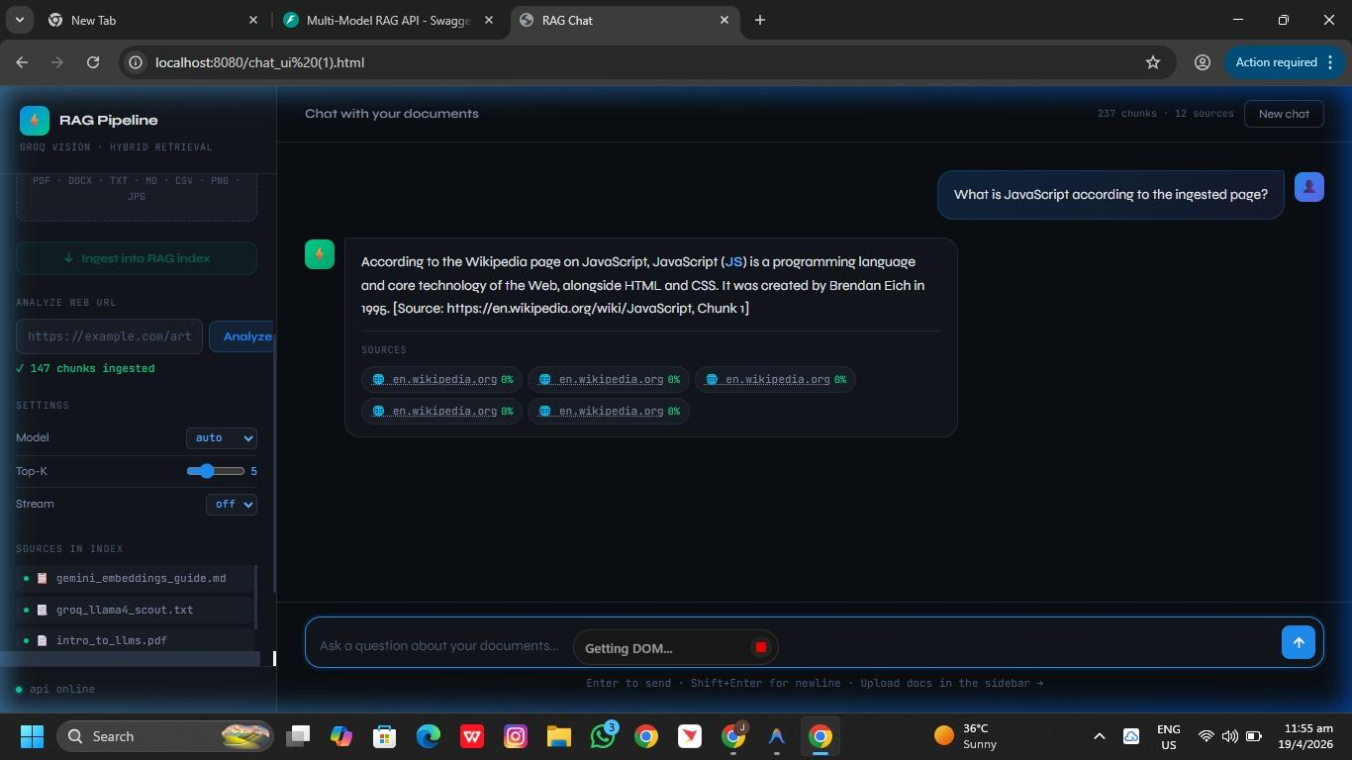
RETRIVAL MODULE
Performs hybrid search using vector methods
Retrieves relevant document information
Ranks results based on similarity
Ensures fast and efficient data access
Improves context-based answer accuracy

Slide 14
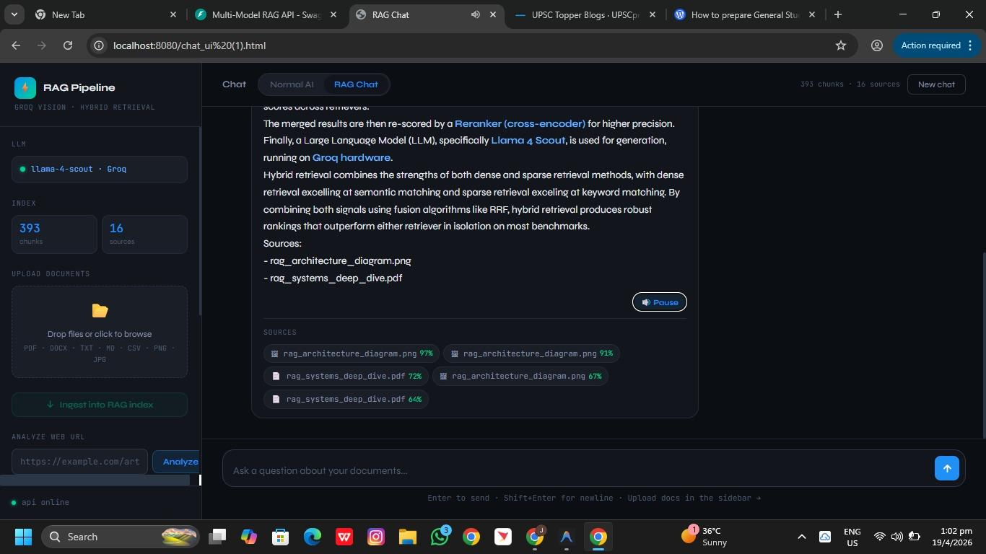
RESPONSE GENERATION AND INTERACTION MODULE
Generates context-aware responses using Groq language models.
Displays responses through the real-time user interface.
Supports interactive query handling and efficient user communication.

Slide 15
CONCLUSION
This project successfully implements a scalable RAG system for accurate, context-aware question answering using multiple AI models and efficient document retrieval techniques.
It provides an interactive full-stack solution integrating frontend, backend, and AI to deliver real-time, intelligent responses from various data sources.

Slide 16
FUTURE ENHANCEMENTS
Add user authentication and personalized document management system
Integrate more advanced and fine-tuned AI models
Improve UI with dashboards and analytics visualization
Enable multi-user collaboration and shared knowledge base
Enhance performance with distributed and scalable architecture

